Slide 1
Dominic Anstey | PhD Student – University of Cambridge
Detecting the First Stars
Using 21-cm Cosmology

Slide 2
Summary
Overview of 21-cm Cosmology
Current State of the Field
Challenges
REACH
Data Analysis Techniques

Slide 3
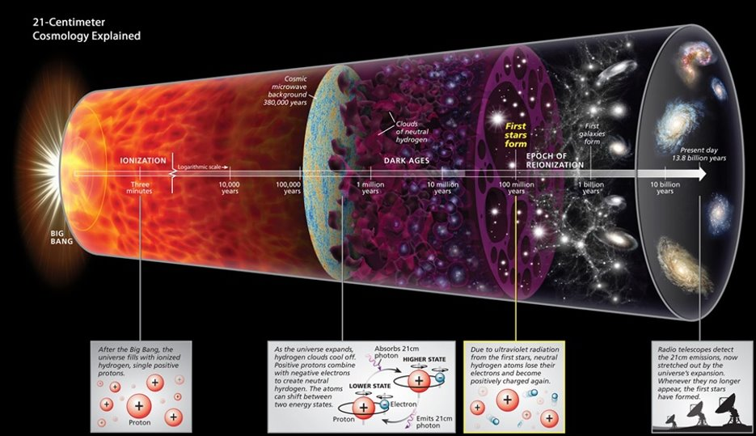
Aims of 21-cm Cosmology
Roen Kelly, Discover Magazine

Slide 4
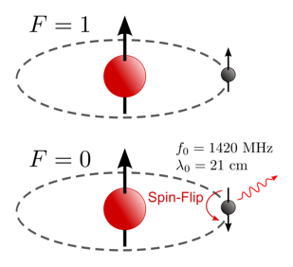
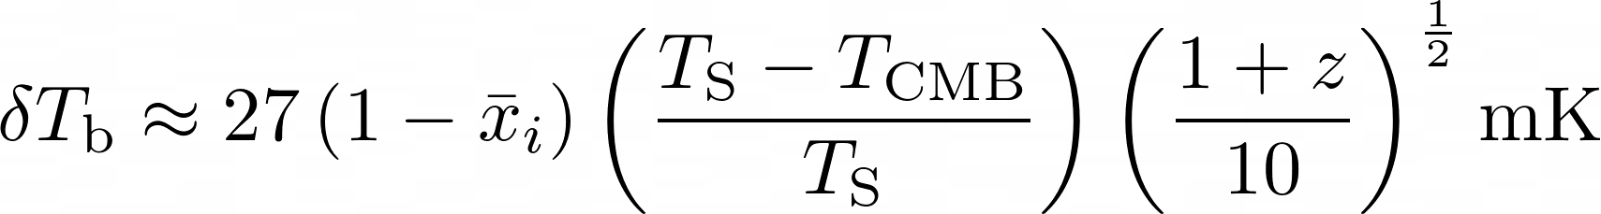
The Hydrogen 21-cm Line
https://en.wikipedia.org/wiki/Hydrogen_line

Slide 5
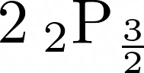
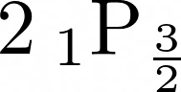
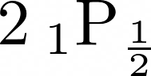
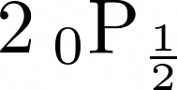
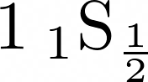
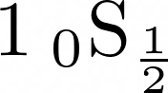
Wouthuysen-Field Effect
Wouthuysen (1952)
Field (1958)

Slide 6
Other Effects
Ionisation
Heating
Collisions

Slide 7
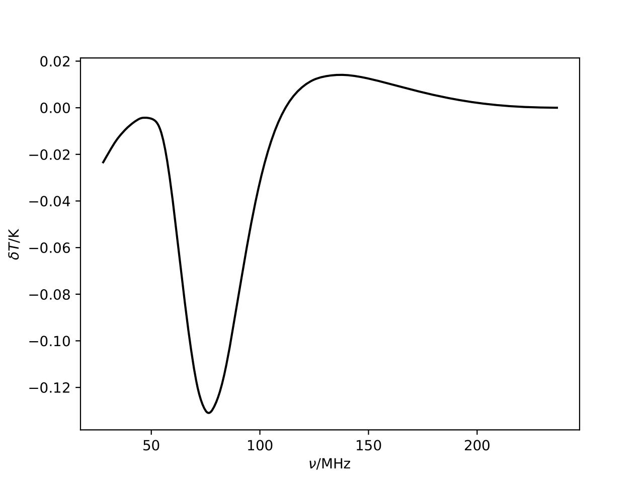
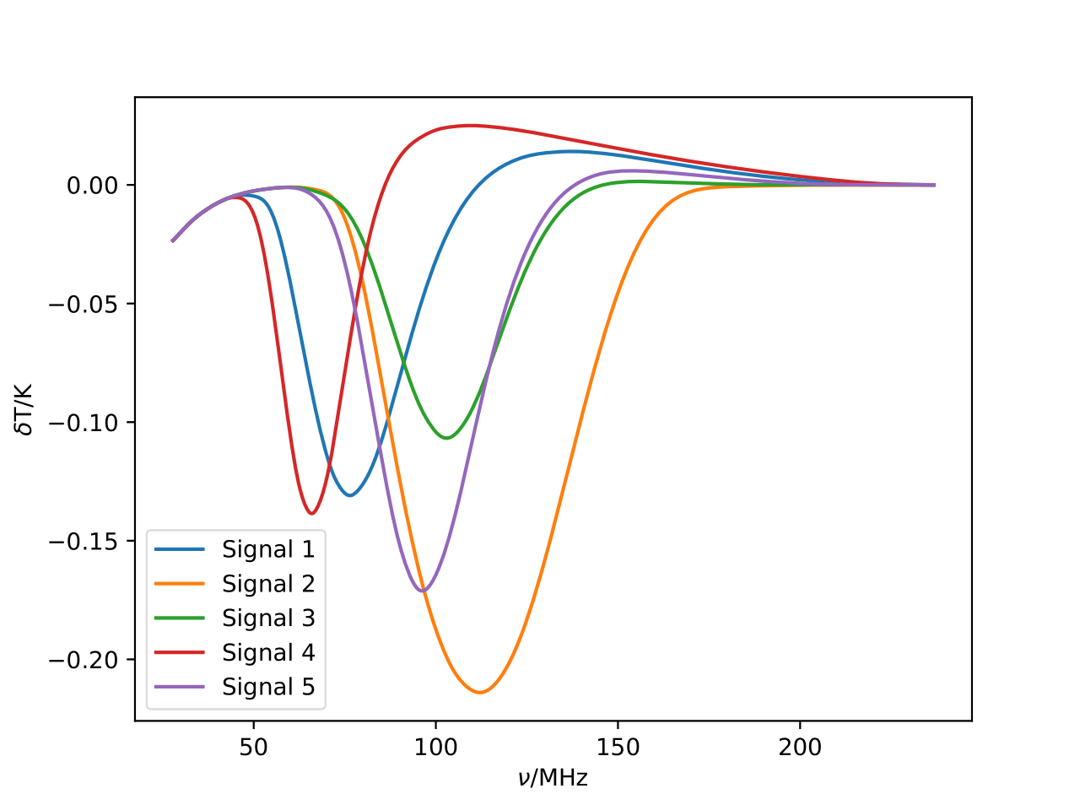
The 21-cm Signal
First Stars
Reionisation
Dark Ages
Heating

Slide 8
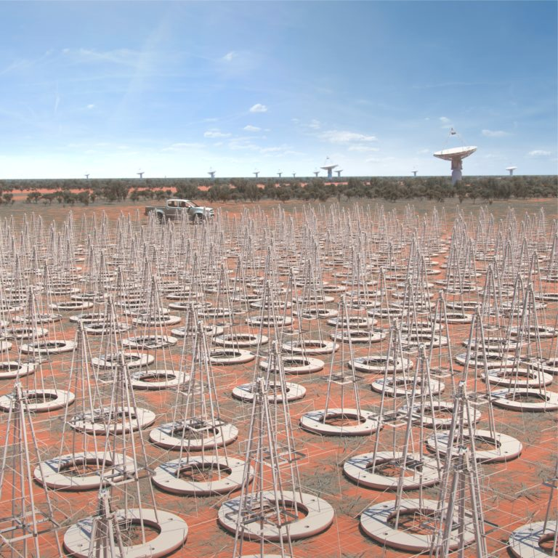
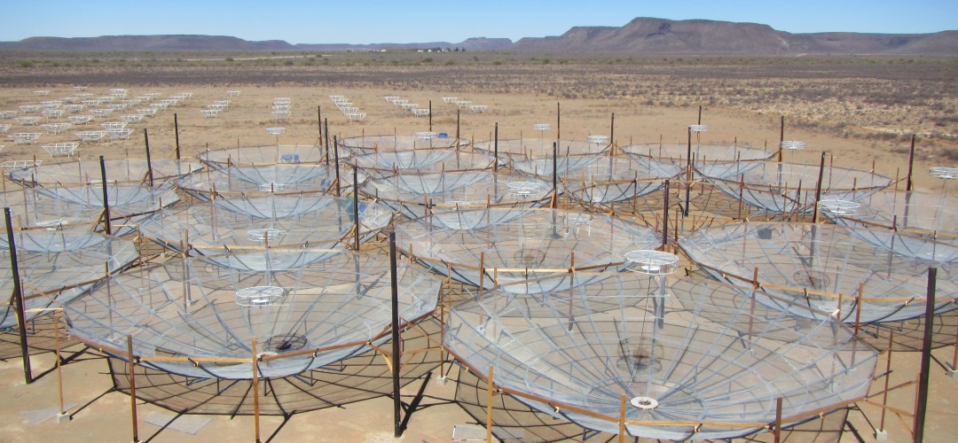
Interferometers
Square Kilometre Array
(SKA)
Hydrogen Epoch of Reionization Array (HERA)
https://www.reionization.org
https://www.skatelescope.org/layout/

Slide 9
Global Experiments
Experiment to Detect the Global EoR Signature (EDGES)
Shaped Antenna measurement of the background RAdio Spectrum (SARAS)
Large-Aperture Experiment to Detect the Dark Ages (LEDA)
Radio Experiment for the Analysis of Cosmic Hydrogen (REACH)
Probing Radio Intensity at high-Z from Marion (PRI^{Z}M)
Etc.

Slide 10
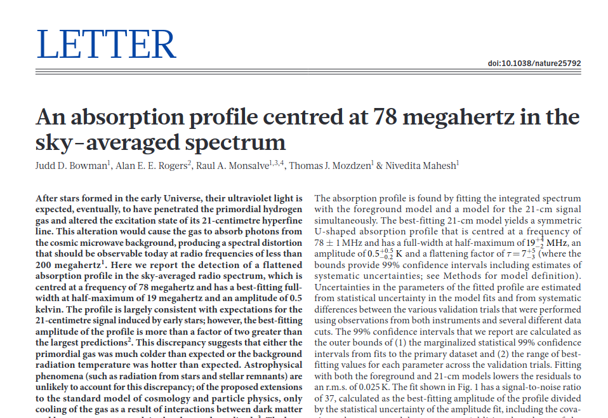
EDGES

Slide 11
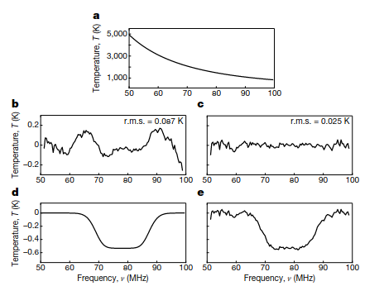
EDGES
Figure 1 of Bowman et al. (2018)

Slide 12
Possible Explanations
Increased Radio Background
AGNs
Radiative decay (e.g. Bolliet et al. 2021)
Annihilating dark matter (e.g. Fraser et al. 2018)
Superconducting cosmic strings (e.g. Brandenberger et al. 2019)
Lowered Gas Temperature
Dark matter interactions (e.g. Liu et al. 2019, Barkana et al. 2018, Berlin et al. 2018)

Slide 13
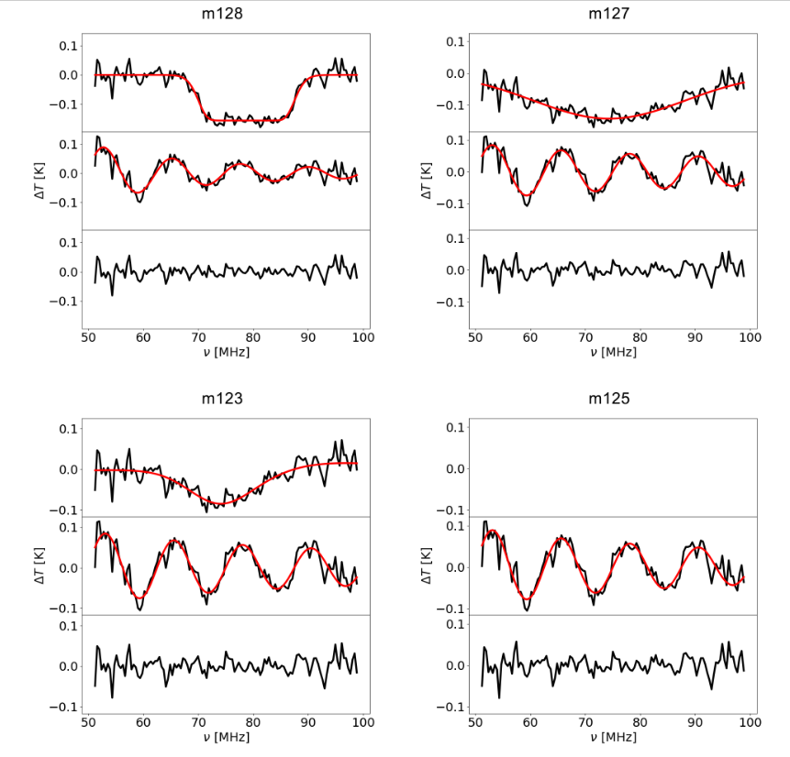
Doubts in Data Analysis
Hills et al. (2018)
Singh and Subrahmanyan (2019)
Bevins et al. (2021)
Figure 2 from Sims and Pober (2019)

Slide 14
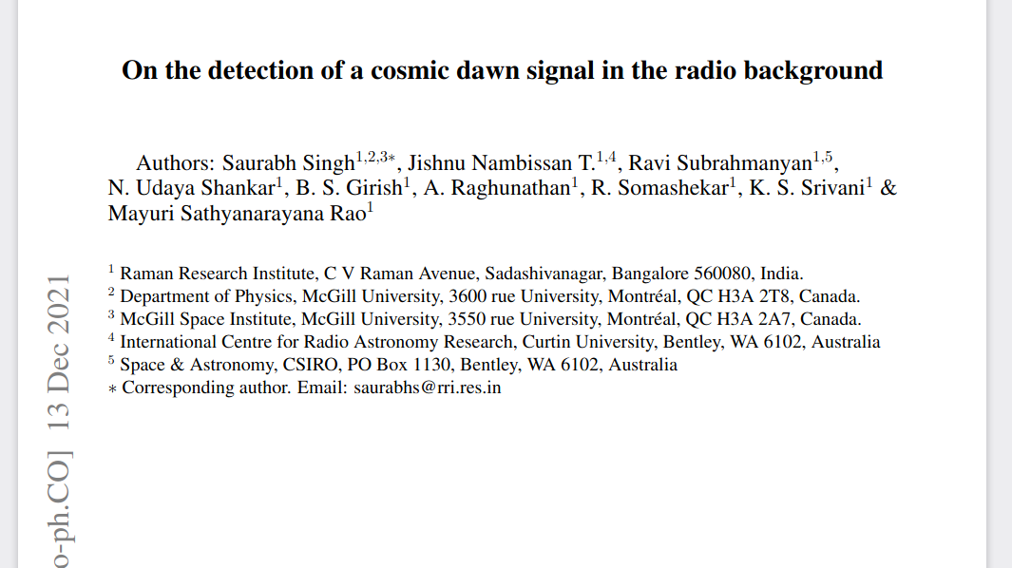
SARAS Results

Slide 15
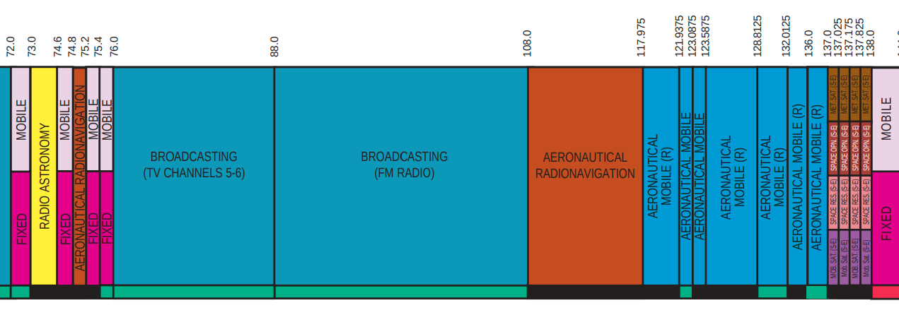
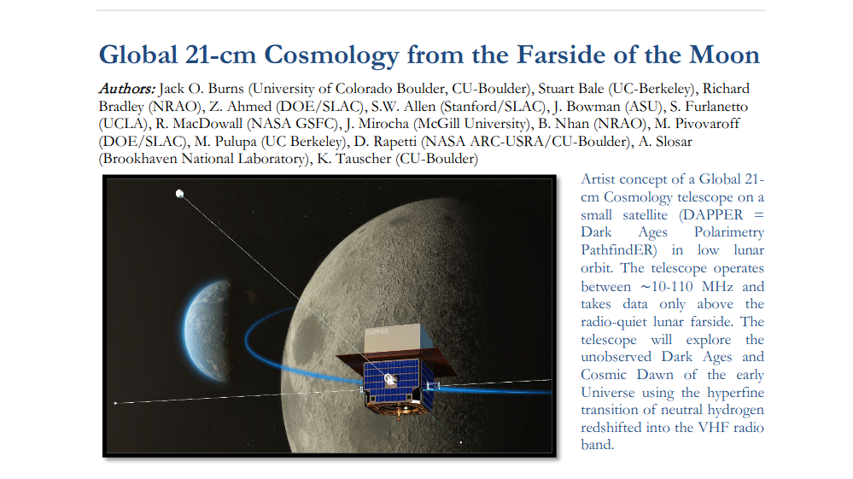
RFI
US Frequency Allocations
https://www.transportation.gov/pnt/what-radio-spectrum

Slide 16
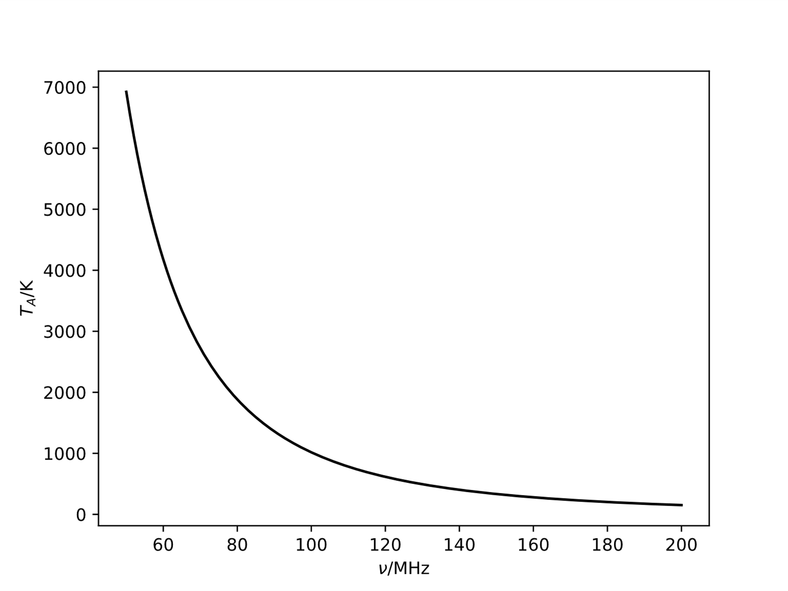
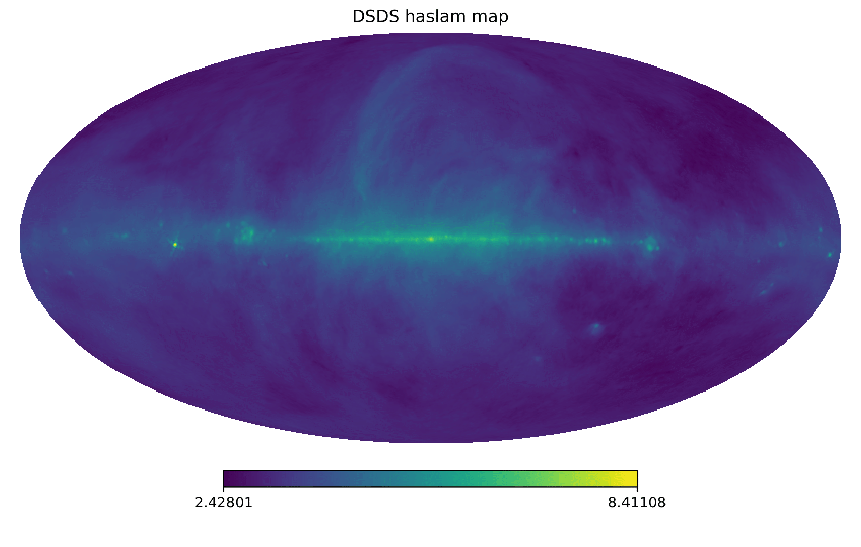
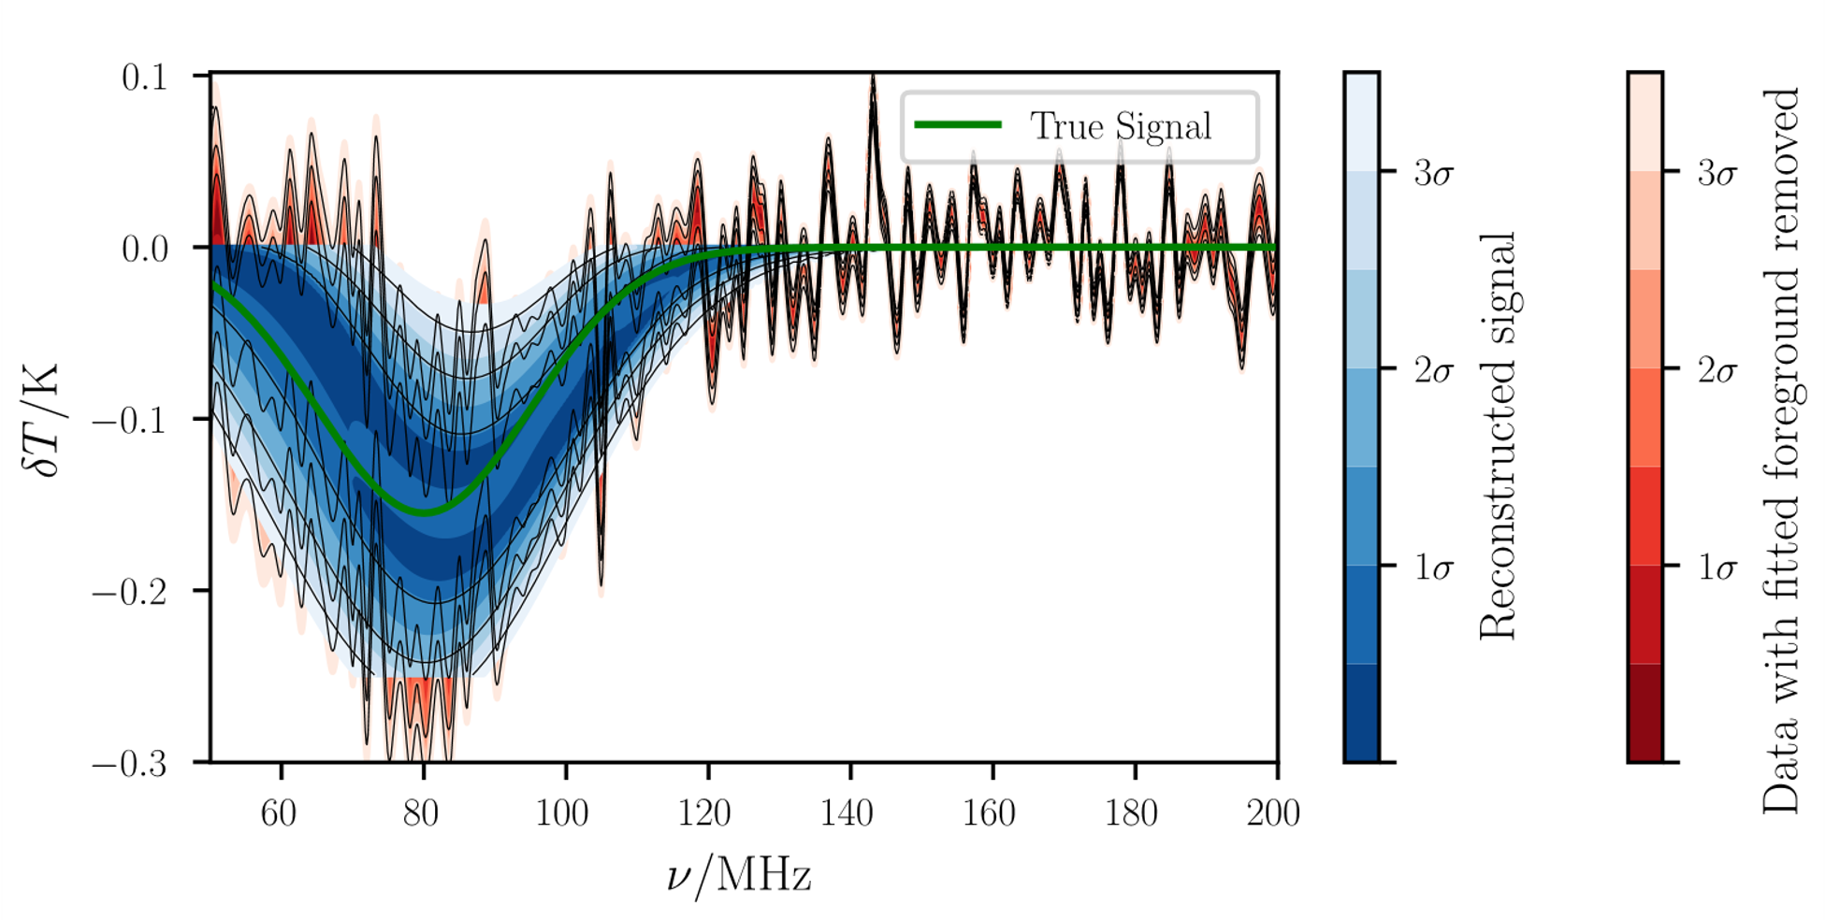
Bright Foregrounds
408 MHz
Remazeilles et al. (2015)

Slide 17
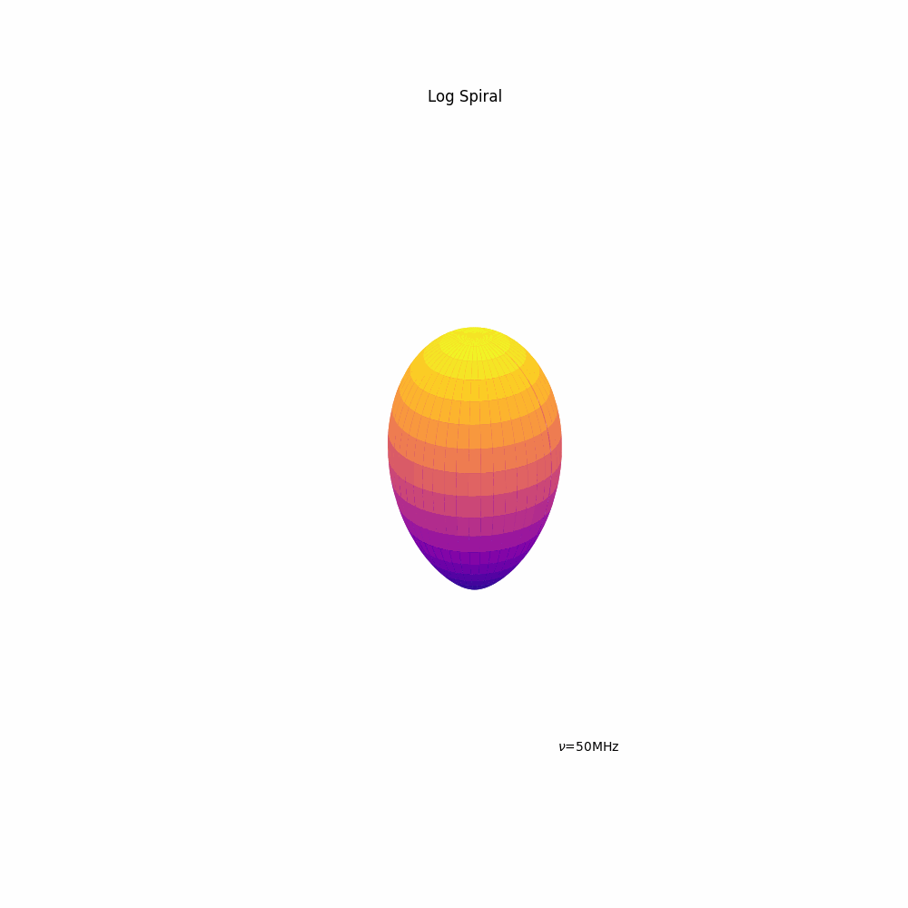
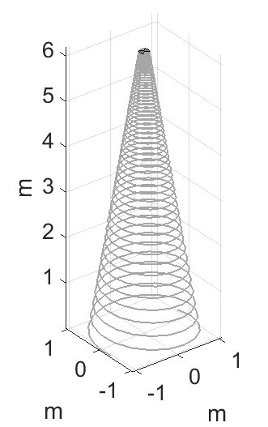
Chromatic Distortion
Antenna simulation and image provided by Quentin Guerring

Slide 18

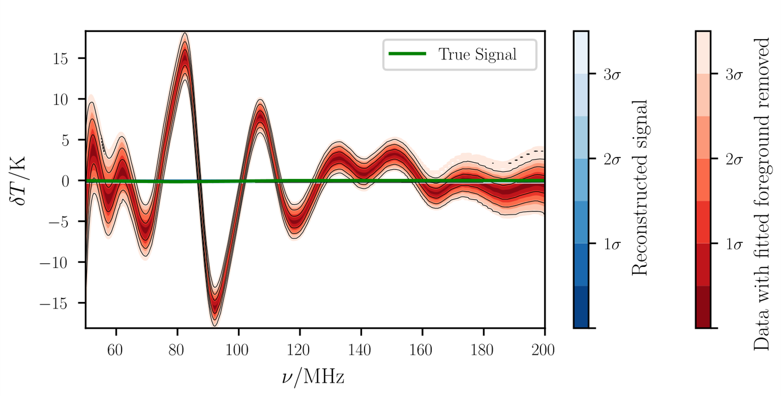
Chromatic Distortion
Achromatic antenna
Chromatic antenna

Slide 19
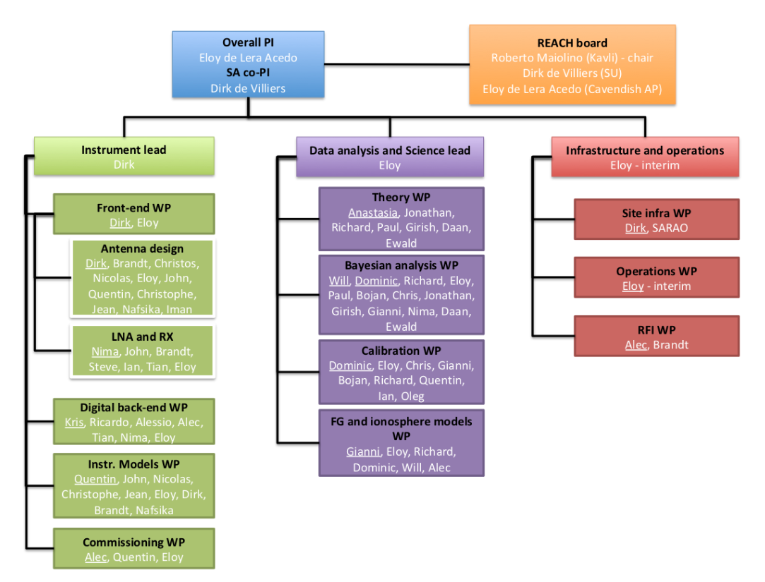


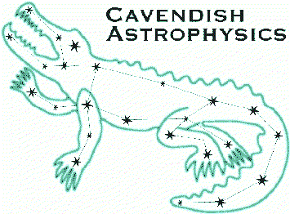















REACH
Kavli Institute
for Cosmology
in Cambridge
The Kavli
Foundation
Cavendish
Astrophysics
Stellenbosch
University
Cambridge
University
National Research Foundation
South African Radio
Astronomy Observatory
Imperial
College
Leibniz-Institut für
Astrophysik Potsdam
Groningen
University
Tata Institute
for
Fundamental
Research
University
Carlos III
Madriid
Université catholique
de Louvain
Oxford
University
University
of Malta
Rhodes
University
Sussex University

Slide 20
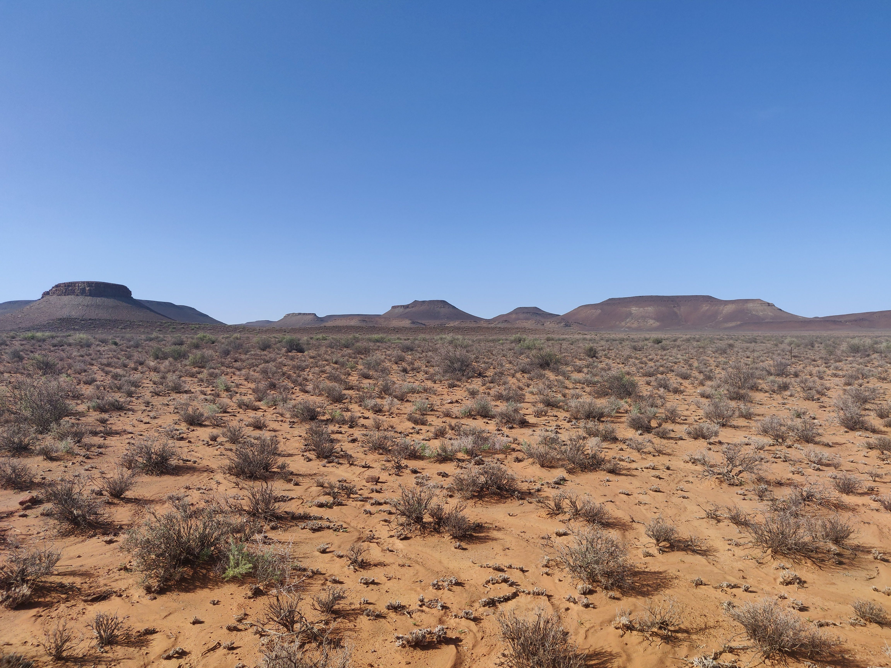
REACH
Designed with Bayesian calibration and data analysis in mind
Use physics-rooted, physically interpretable models to understand and account for systematics
Simultaneous observations with two different antennae

Slide 21
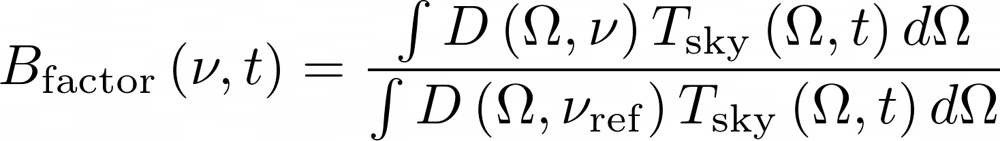
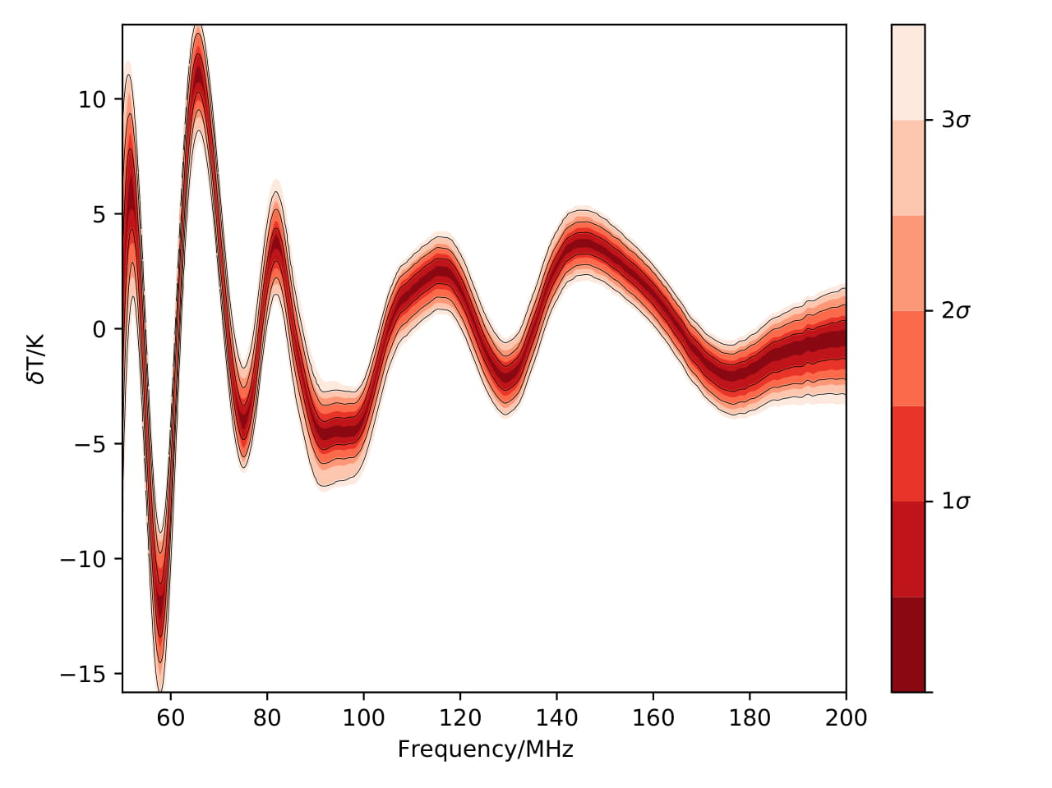
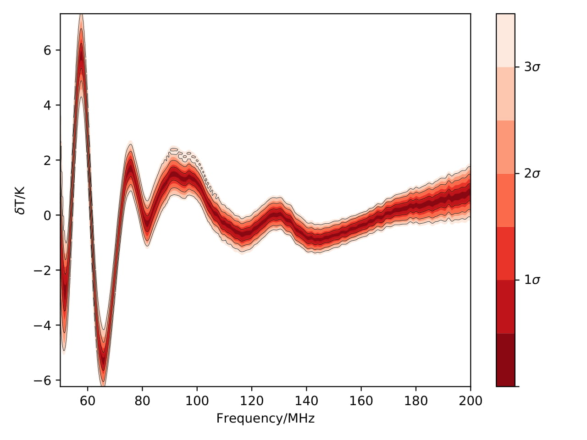
Chromatic Correction Methods
Uncorrected
Corrected
Anstey et al. 2021 (a)

Slide 22
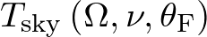
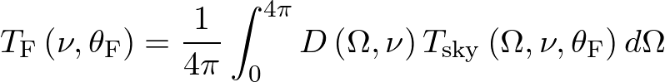
REACH Data Analysis
Generate a model of the sky radio emission based on physical parameters
Convolve this with a model of the antenna beam to produce a parameterised foreground model that includes chromatic distortions
Use this model in a Nested Sampling fit

Slide 23
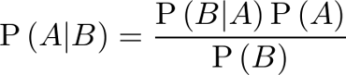
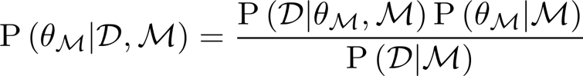
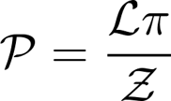
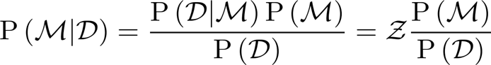
Bayesian Data Analysis

Slide 24
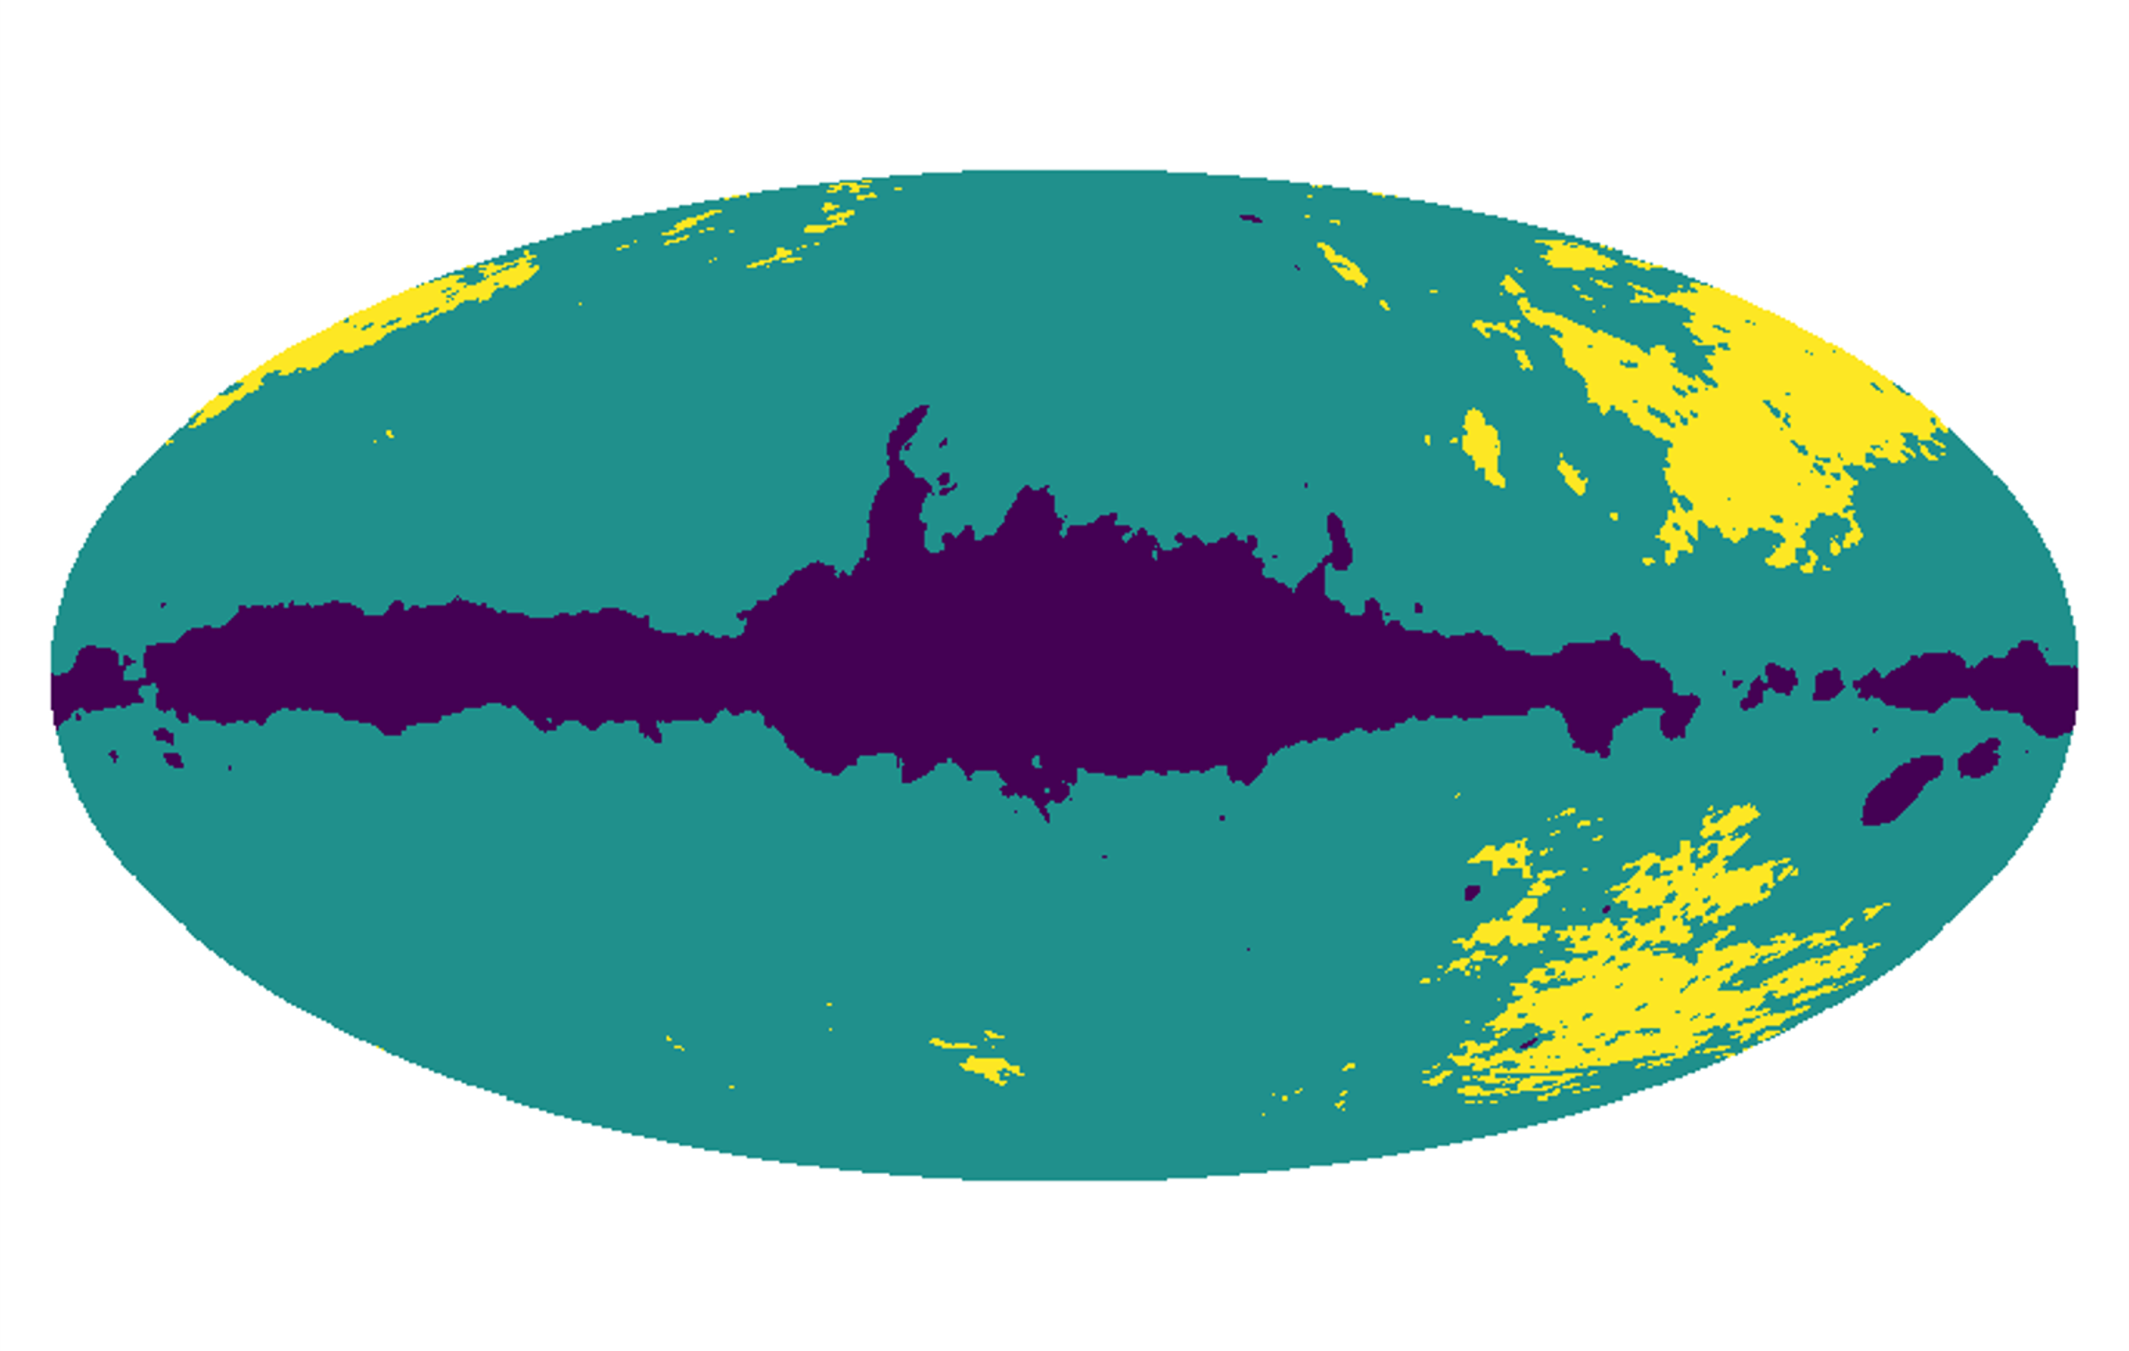
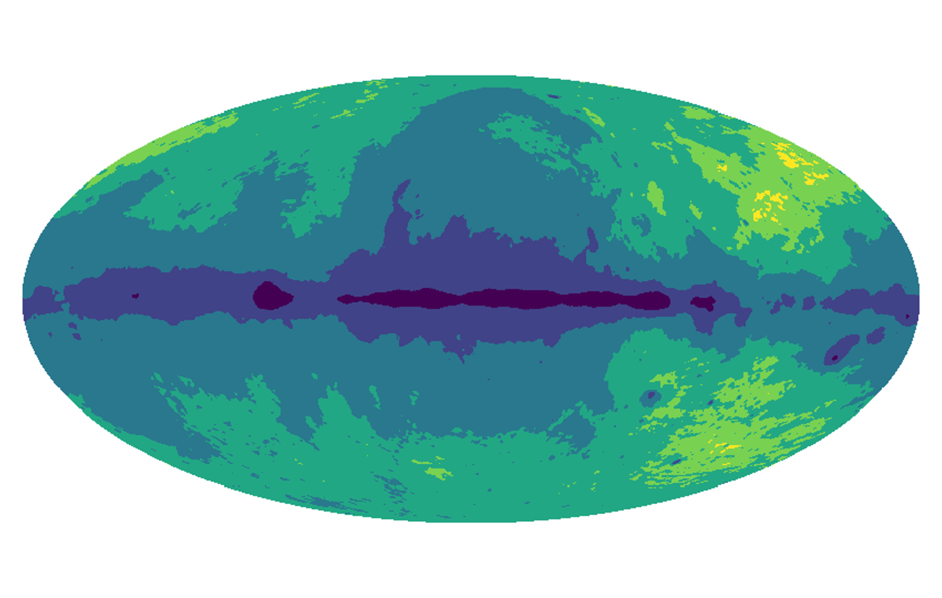
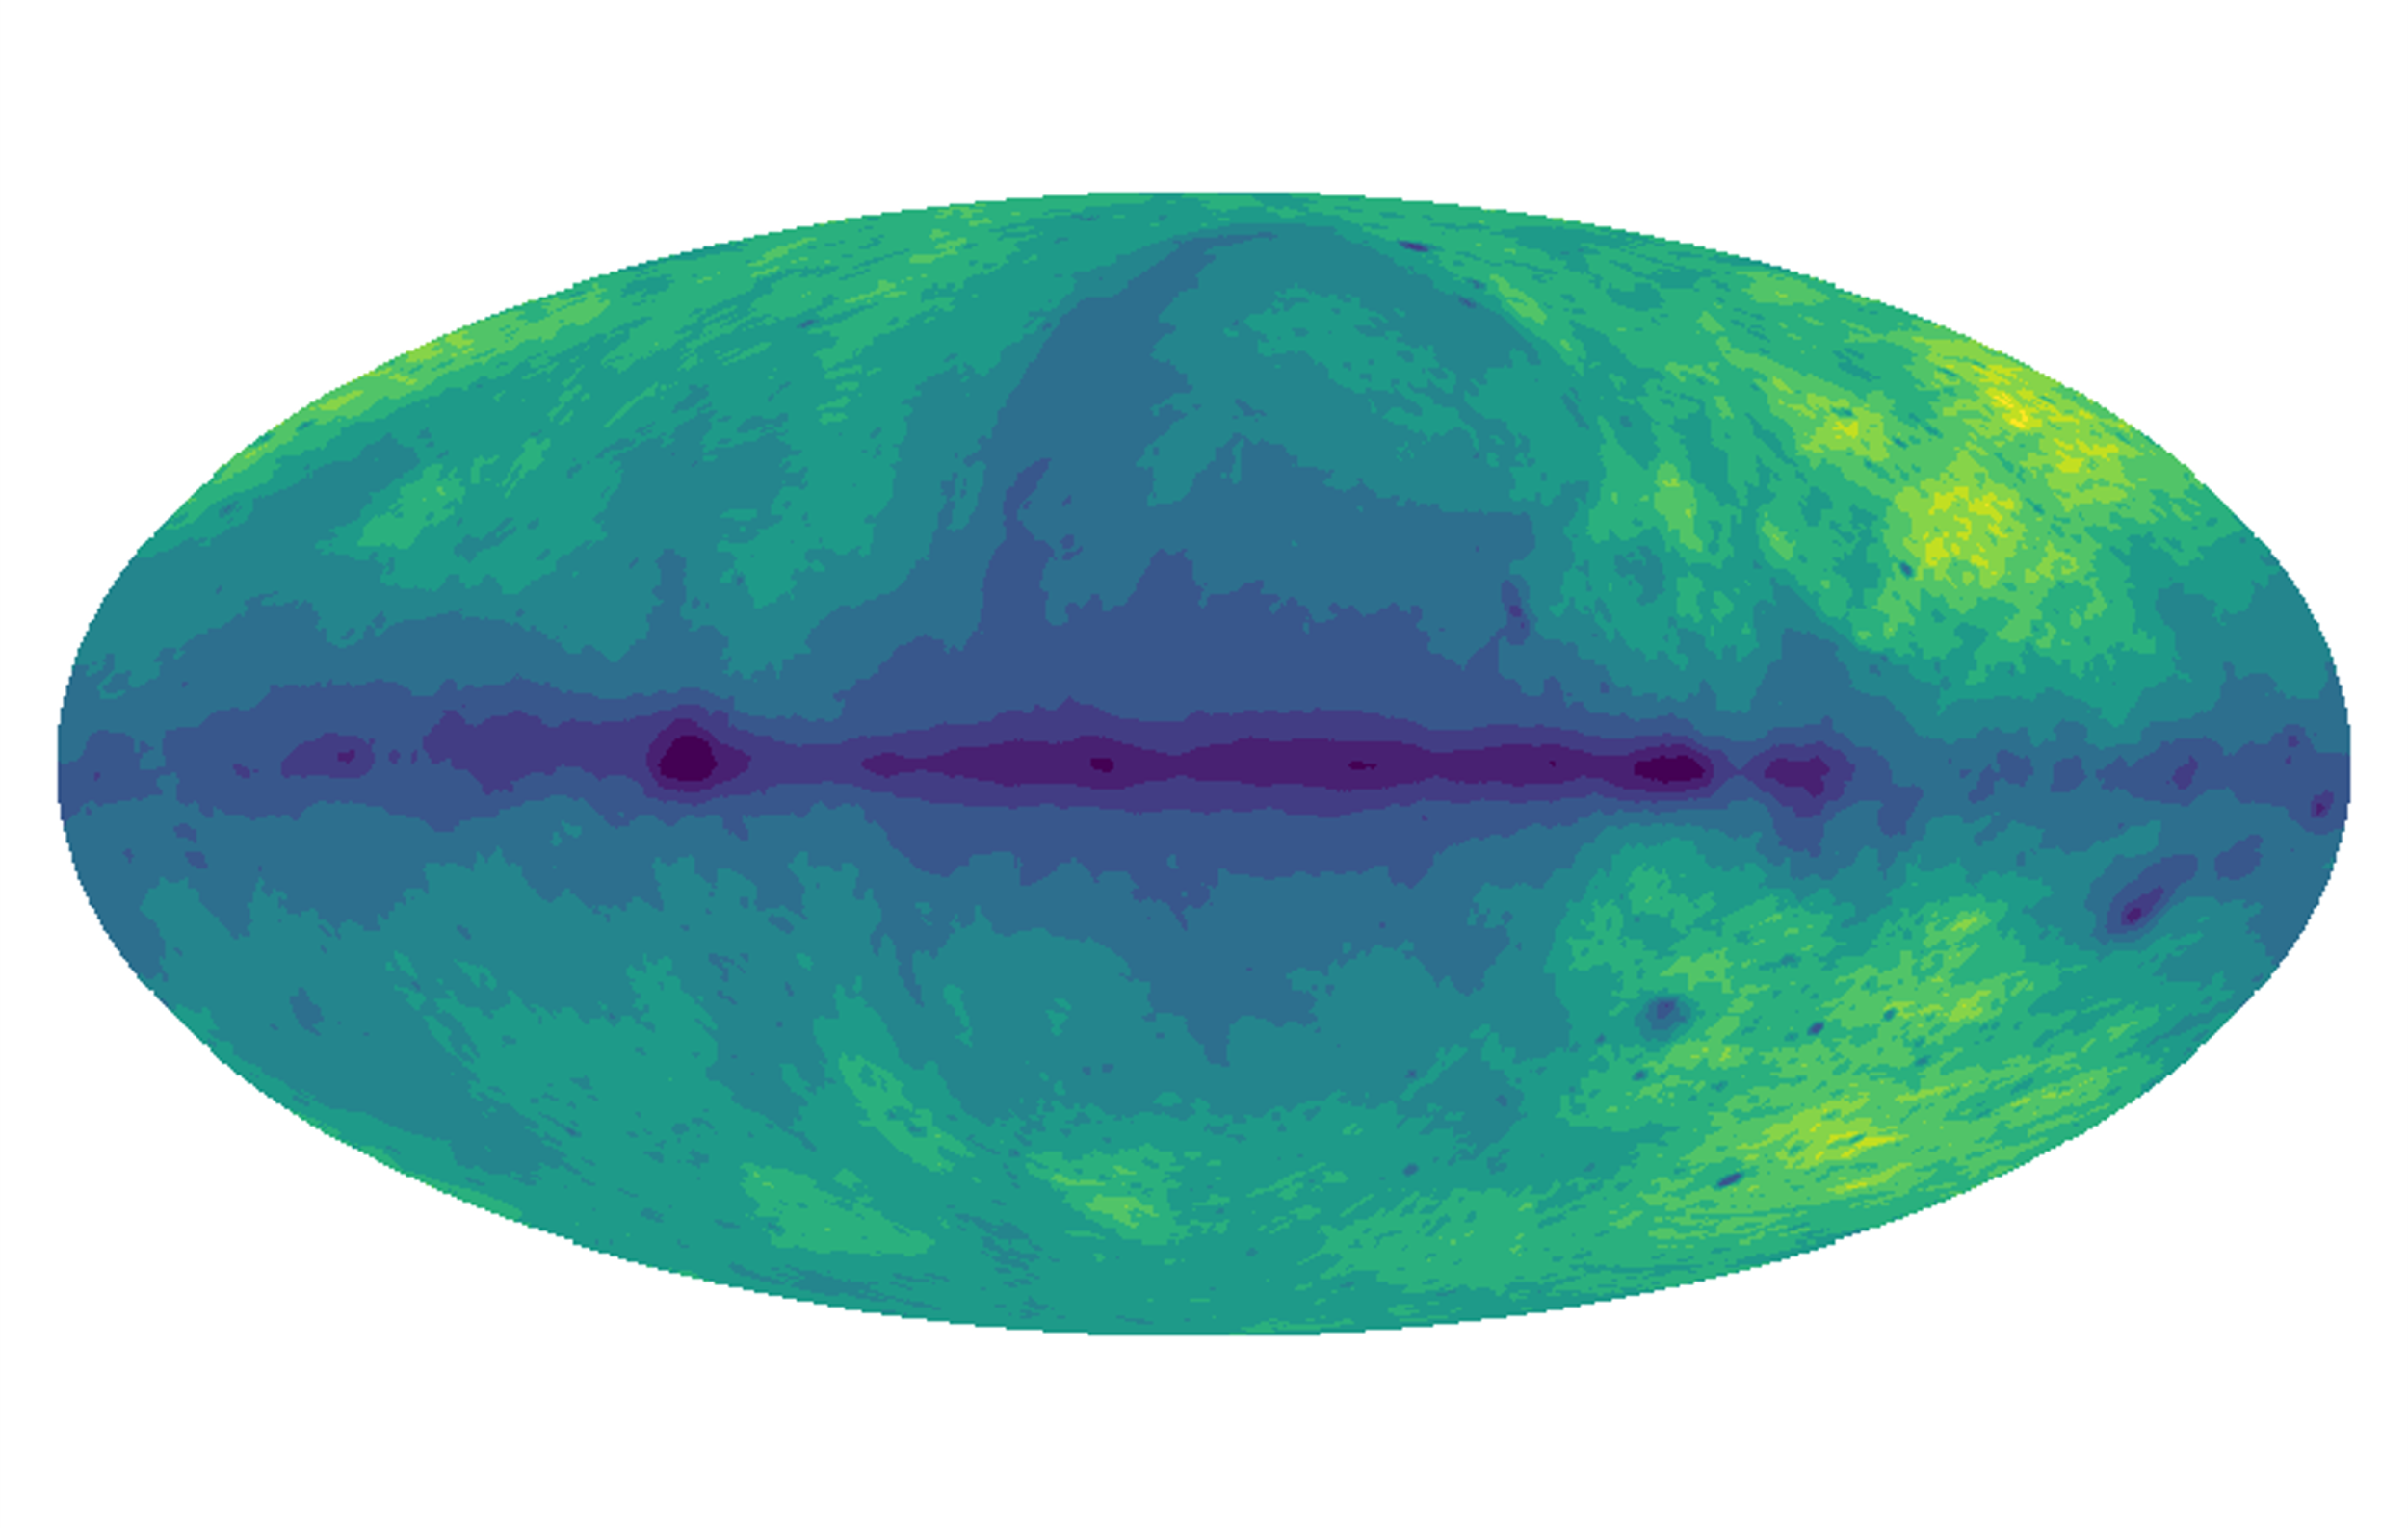
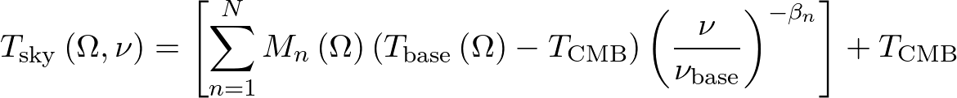
REACH Data Analysis
Parameterise by spectral index
3 Regions
6 Regions
β₆
β₅
β₃
β₄
β₂
β₃
β₁
β₂
12 Regions
β₁

Slide 25
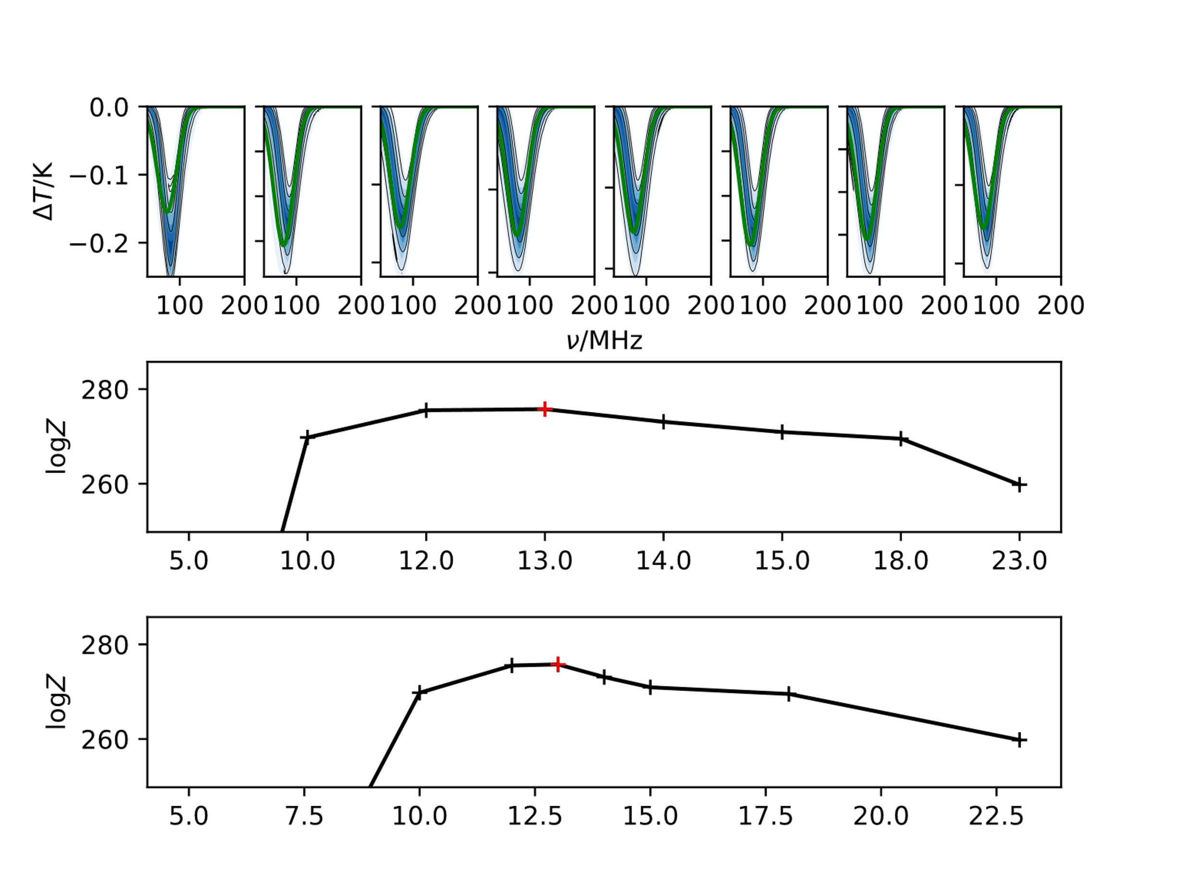

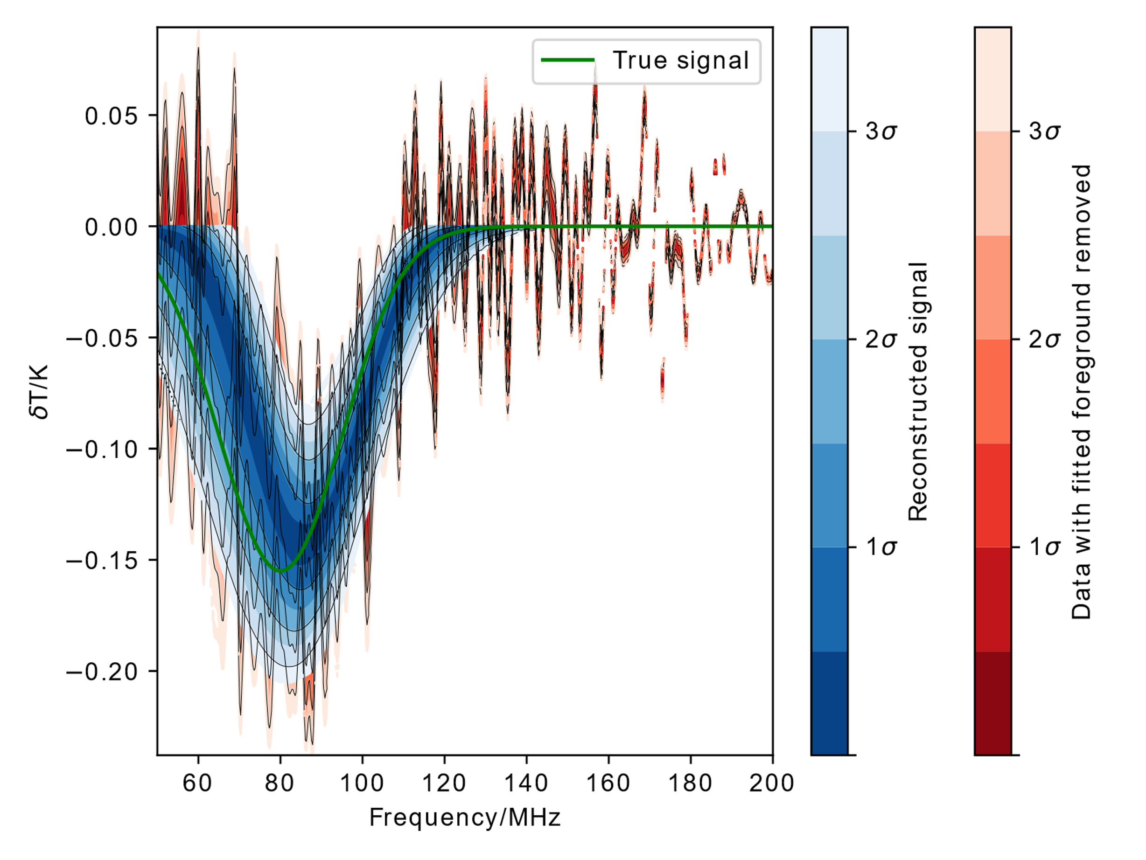
Performance

Slide 26
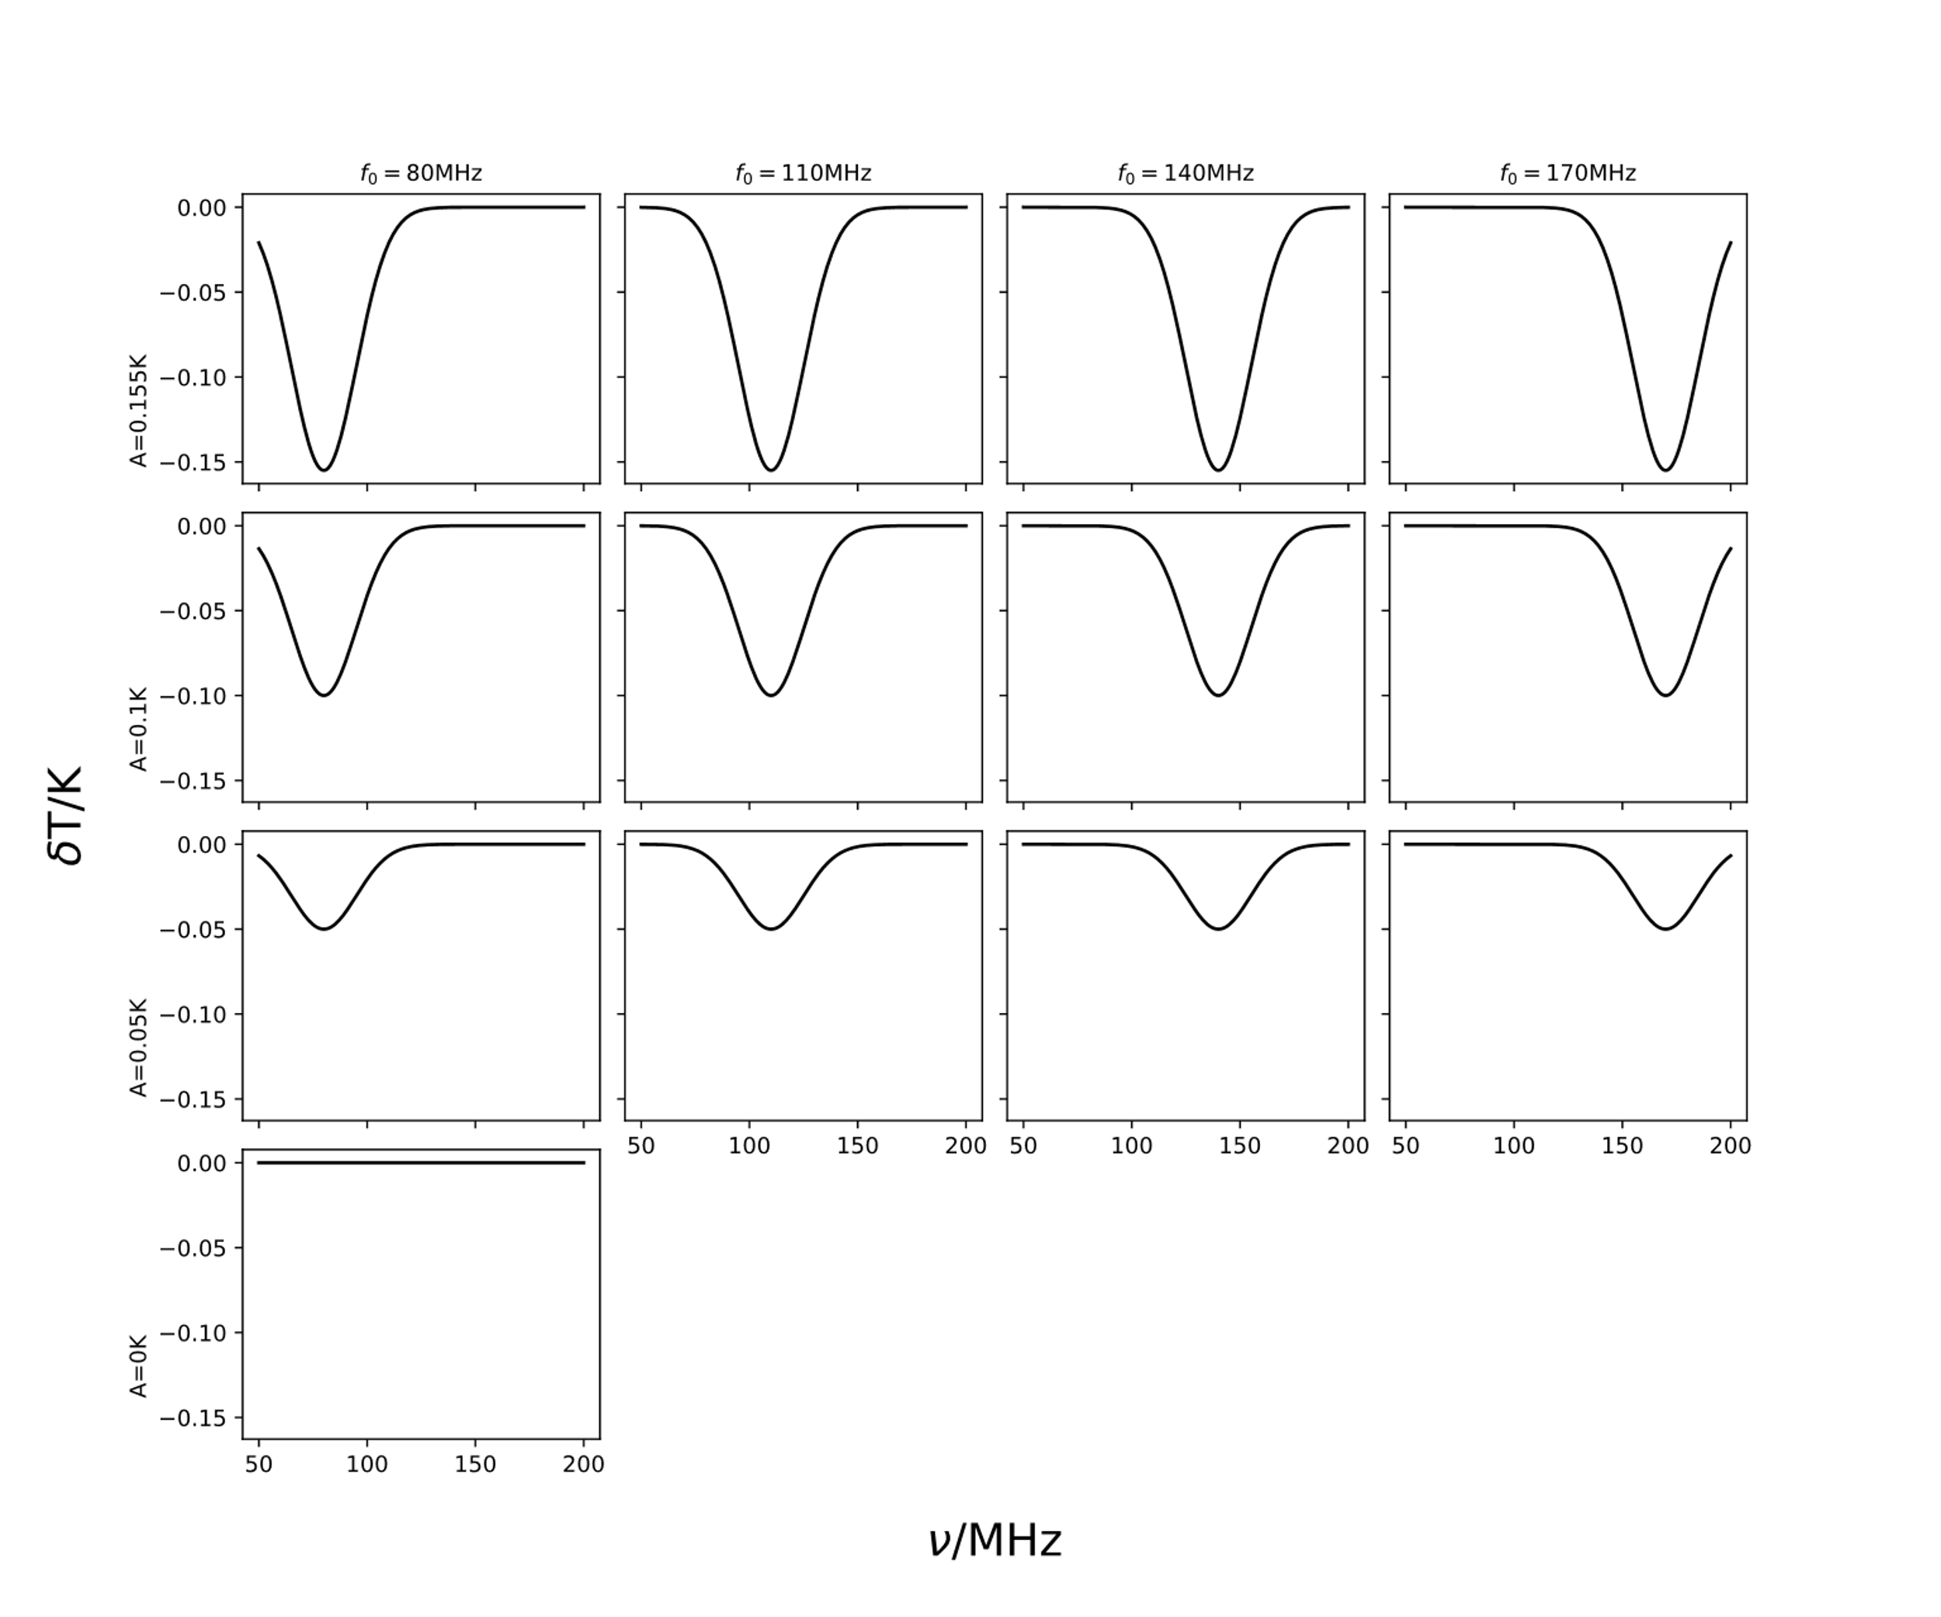
Antenna Comparison
Simulate observation data for a range of potential antenna designs
Insert a range of mock 21cm signals into the data
Attempt to recover each signal using the described pipeline
This allows the accuracy of each recovered signal to be quantified relative to the true signal. We can also quantify the statistical confidence with which the signal is detected.
Anstey et al. 2021 (b)

Slide 27
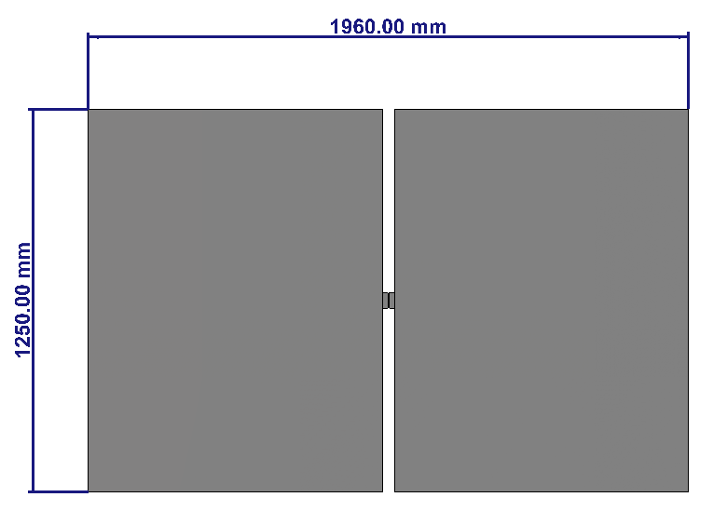
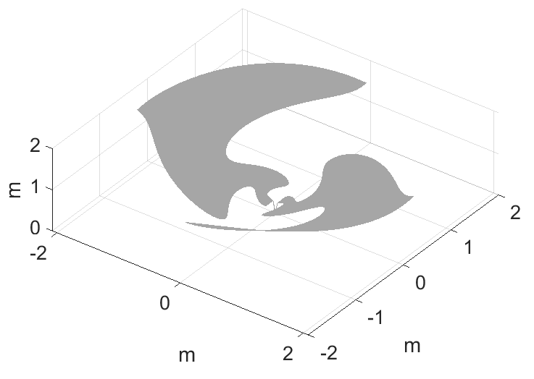
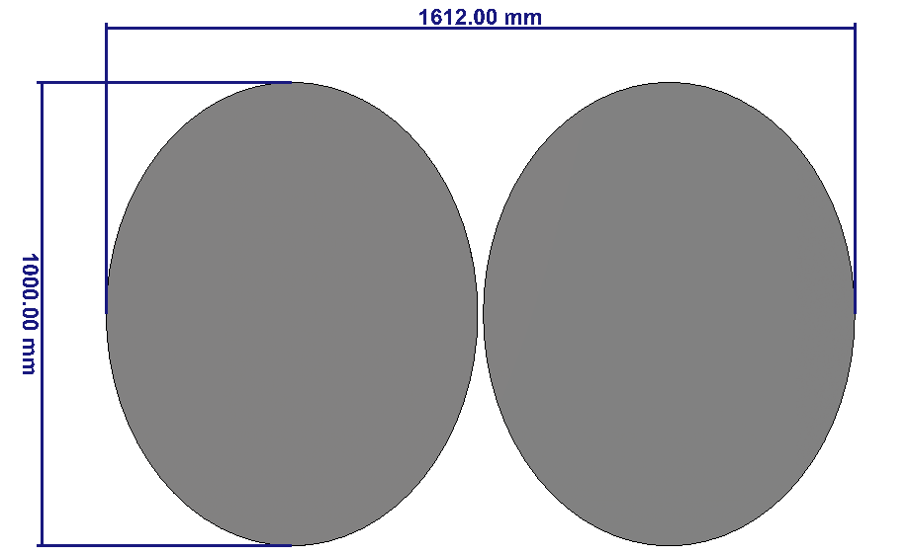
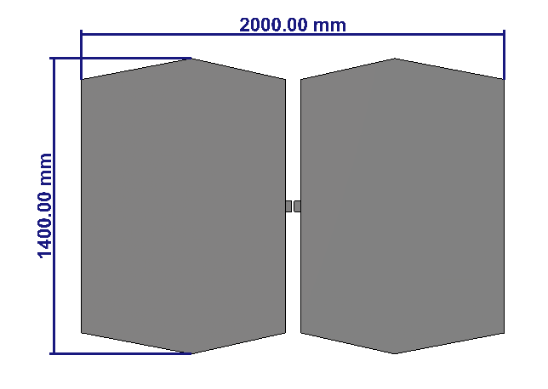
Antenna Comparison
Dipoles:
Rectangular
Elliptical
Inverse Conical Sinuous
Conical Logarithmic Spiral
Antenna simulations and images provided by John Cumner and Quentin Guerring
Polygonal

Slide 28
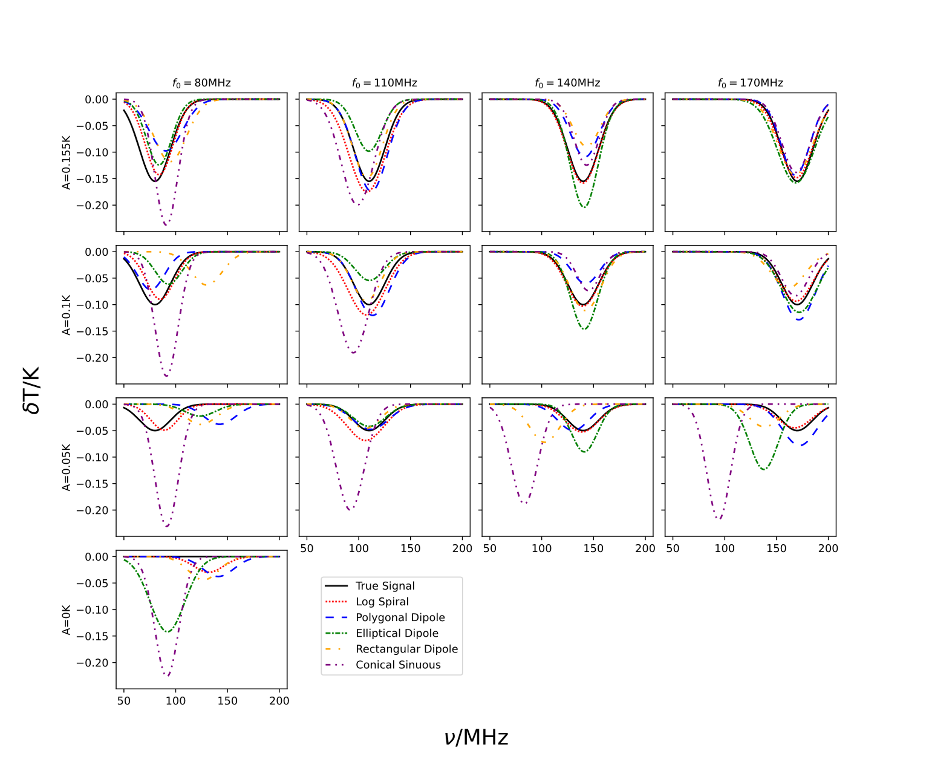
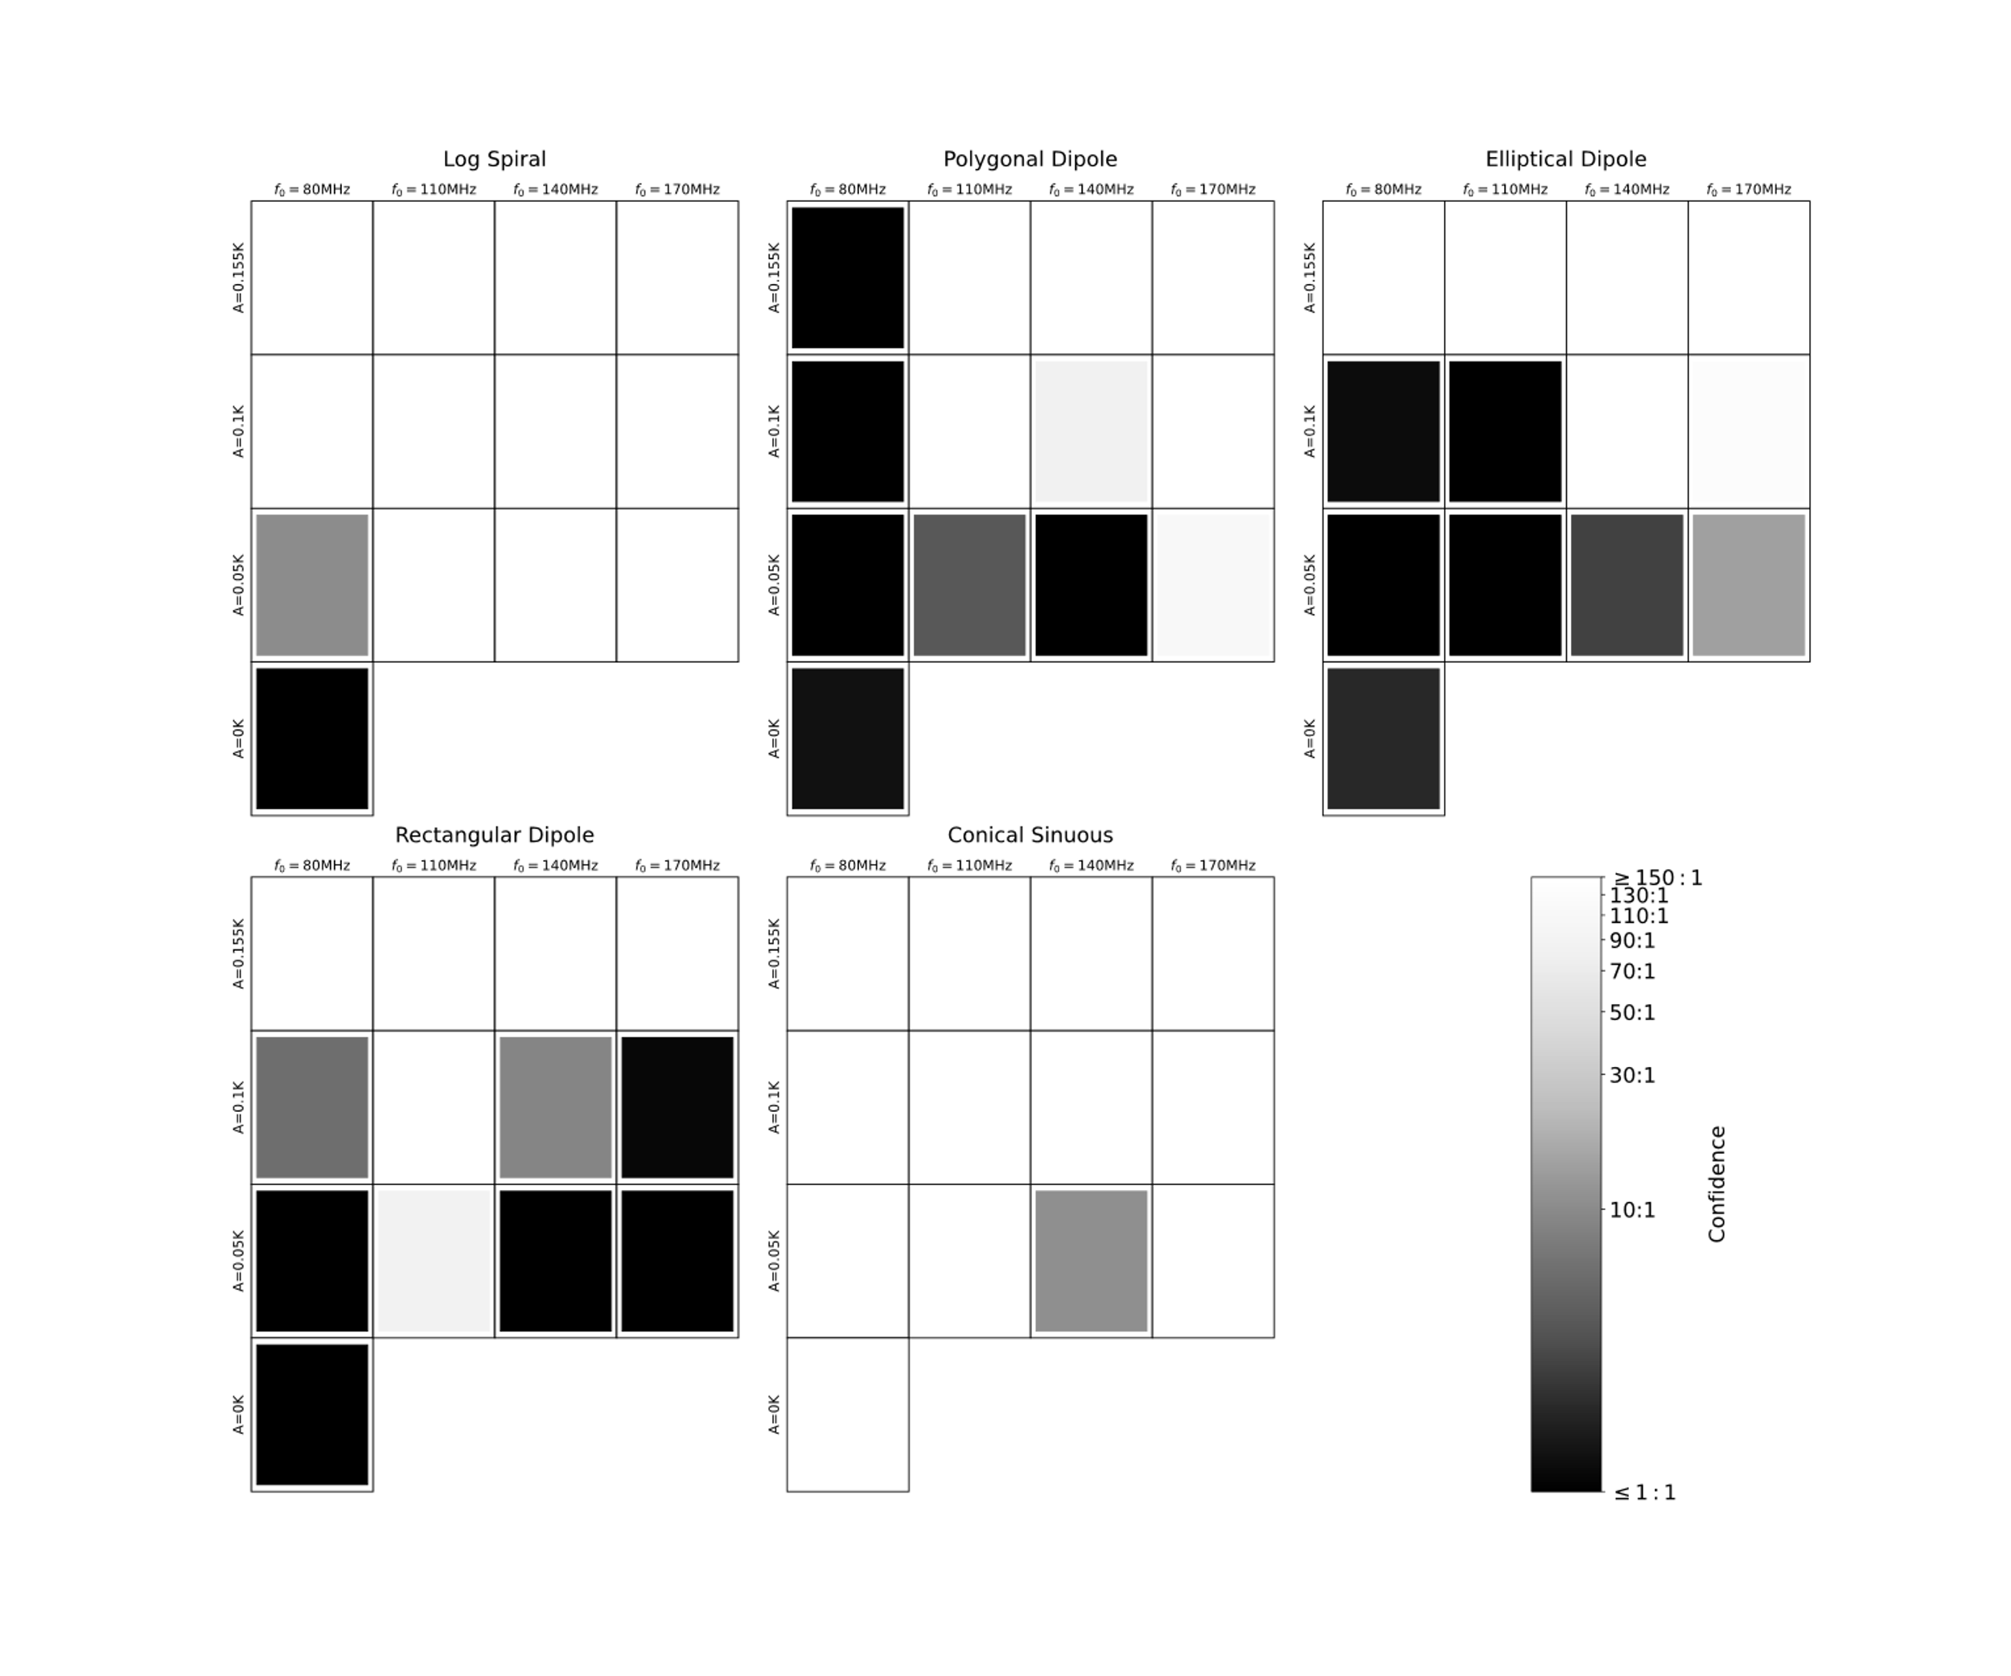
Antenna Comparison
Anstey et al. 2021 (b)

Slide 29

Antenna Comparison
REACH Prototype at Stellenbosch University

Slide 30


Using Multiple Data Sets
β₁
β₂
_{Etc.}
Horizon

Slide 31



Results
Time-averaged
Time-separated

Slide 32


Using Multiple Antennae Sets

Slide 33


Results

Slide 34


Modelling Beam
The antenna beam pattern may not be known exactly in practice:
Soil permittivity
Horizon effects
Imperfections in construction
Etc.

Slide 35


Modelling Beam
Model Beam Coefficients
Fit Results

Slide 36
Conclusions
21 cm Cosmology is one of the most promising methods of studying the dark ages, cosmic dawn and the epoch of reionisation
There is currently no confirmed detection of the 21 cm signal
Producing a detection has numerous challenges
REACH
Core REACH data analysis pipeline
Uses and extensions to this pipeline

